Slide 1
CHILDREN AND YOUNG PEOPLE ON LONG-TERM VENTILATION A review of the quality of care provided to children and young people aged 0-25 years who were receiving long-term ventilation
Recommendations
Notes:
Presenter’s notes:
This presentation can be used to present the principal recommendations from the report Children and Young people on Long-Term Ventilation (LTV). This looked at the care provided to patients aged 0-24 years who were receiving LTV over a two-year period. The study covered the whole of the UK including off-shore islands.
More information can be found at www.ncepod.org.uk.

Slide 2
The study - Aim
The aim of the study was to identify remediable factors in the care provided to people who were receiving, or had received, long-term ventilation (LTV) up to their 25th birthday between the 1st April 2016 – 31st March 2018
Notes:
Presenter’s notes:
The study looked at children and young people, both newly initiated and established on LTV, who had been on ventilation ‘every day for 3 months (invasive and non-invasive) where the intention was to maintain them at home on continued ventilator support (not home oxygen). Their quality care was reviewed across a number of settings along the care pathway including: inpatient, follow-up and community care.

Slide 3
Study method
Data were collected from a number of sources:
1. Number of children and young people on LTV during the study
All patients under the care of an LTV service, or who were admitted any hospital over the two-year study data collection period - 1st April 2016 to 31st March 2018 inclusive.
2. Sampled study population for the clinical peer review process
Lead clinician questionnaire
Community team clinical questionnaire
Acute admission questionnaire
Tracheostomy insertion questionnaire
Case notes
Notes:
Presenter’s notes:
1. Number of children and young people: Study contacts in each participating hospital collated the details of all patients under their Trust/Health Board’s care over the study period, whether admitted or under the care of their LTV service.
2. Sampled study population: From the whole study population two groups were sampled for more detailed review:
People who were already established on LTV: (LTV initiated prior to 1st April 2016)
New tracheostomy insertion: (tracheostomy inserted between the 1st April 2016 – 31st March 2018)
Established patients
Lead clinician questionnaire – all patients
Community team clinical questionnaire – all patients (where it could be identified)
Acute admission questionnaire - & case notes – only where the patient was admitted to hospital between 1st April 2016 – 31st March 2018
New initiations
Tracheostomy insertion questionnaire

Slide 4
Study method
3. Organisational data
Paediatric services
Adult services
4. Service user and parent carer online survey and focus groups
Online survey
Focus groups
5. Health and social care professional online survey and interviews
Online survey
Interviews
Notes:
Presenter’s notes:
3. Organisational data: hospitals defined themselves whether they provided paediatric and/or adult services and completed the questionnaire(s) accordingly. This was sent to both acute and community organisations.
4. No additional notes
5. No additional notes

Slide 5
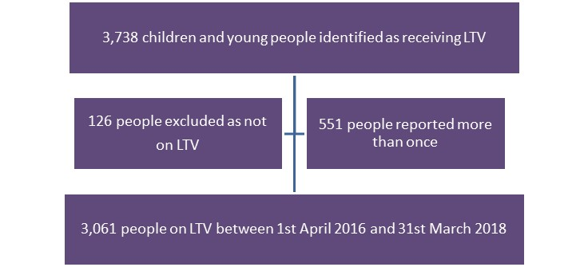
Data returned: Number of CYP receiving ventilation
Notes:
Presenter’s notes:
3,061 patients were reported to be receiving LTV from 113 hospitals within 94 Trusts/Health Boards. This is likely to be an under-representation due to the absence of coding for LTV, which meant there was no way of easily identifying these patients, especially those who had transitioned to adult services.
Out of 3,061 people receiving LTV (likely to be an under-representation based on the absence of coding), 473 patients were selected for review. Of those 231 were selected for the case note review and 149 sets of case notes were received.

Slide 6
Data returned: Sampled study population
3,061 people receiving LTV
(likely to be an under-representation based on the absence of coding)
Established LTV pathway
392
New tracheostomy insertions
81
231 acute admissions
161 non- admissions
Tracheostomy insertion questionnaires received
50
Acute admission questionanires received
152/231
Case notes returned
149/231
Community team questionnaires received
96/166
(not all community teams could be identified)
Lead clinician questionnaires received
229/345
(not all lead clinicians could be identifed)
Notes:
Presenter’s notes:
Out of 3,061 people receiving LTV 473 patients were selected for review.

Slide 7
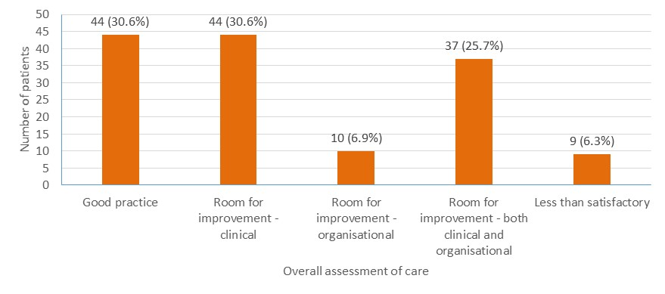
Overall assessment of care
Notes:
Presenter’s notes:
Case note reviewers assessed the overall quality of care for each case. The overall quality of LTV care was stated to be good in 44/144 (30.6%) cases reviewed. Room for improvement was identified in clinical care alone in 44/144 (30.6%) cases, organisational care alone in 10/144 (6.9%) cases and both clinical and organisational care in 37/144 (25.7%) cases. In 9/144 (6.3%) cases reviewed care was reported to be less than satisfactory.

Slide 8
Key messages (1)
1. Service planning and commissioning of integrated services
Formalisation of the service planning and commissioning of LTV services through an integrated network of care providers is required.
2. Multidisciplinary care
Improved access to an appropriate multidisciplinary care team is needed to ensure people on LTV and their parent carers can be supported in the community as well as during an admission to hospital.
Notes:
Presenter’s notes:
Five key messages agreed as the primary focus for action have been derived from 11 recommendations
Service planning: The aim of formalisation would be to reduce variability in access to services; to facilitate discharge, to enable respite care, and to simplify equipment purchasing and servicing arrangements
2. No additional notes

Slide 9
Key messages (2)
3. Emergency healthcare plans
Templates for Emergency Healthcare Plans should be developed and standardised for people receiving LTV.
4. Discharge planning
Active discharge planning should start at the point of an admission
5. Transition from child to adult services
Transition planning should minimise disruption and prepare for any necessary changes that will occur.
Notes:
Presenter’s notes:
3. Emergency healthcare plans: These should provide information about what and who to contact in an emergency and form part of hand-held records that are accessible to all (person receiving LTV, parent carers & health and social care teams)
4. Discharge planning: This should include all relevant members of the integrated care network to enable a prompt and safe discharge. The plan should reflect any changes in respiratory care.
5. Transition: Effective leadership for planning transition should be encouraged. There should be no gap in the provision of LTV care.

Slide 10
Recommendation 1
Ensure service planning/commissioning of integrated care pathways for long-term ventilation services includes formal contract arrangements and local standardisation where possible.
These arrangements should bridge child and adult health as well as social care services, respite care and any other partnerships relevant to the local network. Networks should map commissioning arrangements to ensure integration and consistent standards of care and national commissioners should provide a forum to ensure that long-term ventilation provision is considered collectively and delivered to agreed standards.
Notes:
Presenter’s notes:
Target audiences: Service Planners/Commissioners (National and Local) with support from Trust/Health Board Executive Committees, Social Care, Primary Care, Education, Respite/Hospice Care, Healthcare Professionals in all hospitals (including those that are not LTV centres) and Third Sector Organisations

Slide 11
Recommendation 2
Ensure that it is possible to identify all people who are receiving long-term ventilation.
Locally this should be achieved by implementing/maintaining a database as soon as possible
Nationally this should be achieved by developing procedure codes for long-term ventilation to bring together the local data collection and support a national database to quantify service provision and facilitate quality improvement
Notes:
Presenter’s notes:
Target audiences: LTV Services and NHS Digital, NHS England, NHS Improvement, NHS Scotland, NHS Wales Informatics Service, Northern Ireland Statistics and Research Agency with support from Trust/Health Board Executive Committees, Social Care and Service Planners/Commissioners

Slide 12
Recommendation 3
Ensure efficient care planning and discharge by providing a multidisciplinary team as part of an integrated care pathway.
This team should work across community and hospital networks of care for child and adult long-term ventilation services, have an identified clinical lead and include as a minimum:
Medical and nursing staff
Physiotherapy
Speech and language therapy
Psychology
Where applicable
A specialist in tracheostomy care
Palliative care/hospice care
Local service planners/commissioners
Notes:
Presenter’s notes:
Target audiences: Service Planners/Commissioners and Trust/Health Board Executive Committees with support from LTV Services, Social Care and Hospice/Respite Care, Psychology and Palliative Care

Slide 13
Recommendation 4
Undertake shared decision-making at the point of long-term ventilation initiation, particularly if it is likely to be a life-long therapy.
The decision-making process should include input at all stages from:
Children and young people (where ever possible)
Parent carers
The multidisciplinary team (MDT) listed in Recommendation 3
The person’s general practitioner whenever practical/possible
Palliative care when appropriate
The process* should also include:
Discussions over a period of time to ensure decisions are thoroughly considered
Input from independent healthcare professionals for peer review/mediation as required
Provision of approved written and/or online information
Support from other families with a child on long-term ventilation should be considered
Notes:
Presenter’s notes:
*A nationally agreed decision-making and ethical framework for long-term ventilation care as proposed by Ray et al should be considered to aid the process. This should involve children, young people and their families as key partners in any development
Ray S et al. 2018. Towards developing an ethical framework for decision-making in LTV in children. Archives of Disease in Childhood. 103(11): 1080–1084
Target audiences: Children and Young People, Families, Service Planners/Commissioners and Trust/Health Board Executive Committees with support from LTV Services, Social Care and Hospice/Respite Care, General Practice, Palliative Care, Medical and Surgical Royal Colleges, Clinical Networks, NHS England and the Departments of Health in the Welsh, Scottish Government and Northern Ireland Governments

Slide 14
Recommendation 5
Ensure that the planning for transition from child to adult services, including the provision of joint transition clinics, has clearly identifiable clinical and executive leadership and forms part of an integrated care pathway for people on long-term ventilation.
Developmentally appropriate and patient-centred transition planning should commence at the latest by the age of 14 years
Notes:
Presenter’s notes:
Target audiences: Children and Young People, Families, LTV services and Trust/Health Board Executive Committees with support from Clinical Directors, Healthcare Professionals in all hospitals (including those that are not LTV centres), Social Care, Primary Care and Service Planners/Commissioners

Slide 15
Recommendation 6
Provide a structured training programme and associated resources for long-term ventilation which prepares:
People on LTV and parent carers for home care
Community providers for routine care
Non-specialist clinicians for hospital admissions
Notes:
Presenter’s notes:
Target audiences: Health Education England, NHS Education for Scotland, Health Education and Improvement Wales and Department of Health Northern Ireland with support from, Children and Young People, Families, LTV Services, Medical Royal Colleges, Specialty Associations, Service Planners/Commissioners and Third Sector Organisations

Slide 16
Recommendation 7
Standardise arrangements for long-term ventilation equipment including:
Purchasing
Servicing
Consumables
Notes:
Presenter’s notes:
Target audiences: Service Planners/Commissioners and LTV Services

Slide 17
Recommendation 8
Standardise templates for personalised Emergency Healthcare Plans for all people on long-term ventilation. They should:
Be easily accessible by all members of the care team
Be clearly laid out so that information can be easily recognised by all members of the care team
Be reviewed at least annually, and after every hospital admission, by the clinical team and the service user/parent carer
Form part of any hand-held records
Include a fast-track admission plan
Notes:
Presenter’s notes:
Target audiences: LTV Services with support from Healthcare Professionals in all hospitals (including those that are not LTV centres), Service Users and Third Sector Organisations

Slide 18
Recommendation 9
Ensure all people on long-term ventilation have access to age appropriate emergency care by a team with the relevant competencies, regardless of location
Notes:
Presenter’s notes:
Target audiences: Trust/Health Board Executive Committees with support from LTV Services, Emergency Care, Ambulance Trusts, Critical Care Services and Healthcare Professionals in all hospitals (including those that are not LTV centres)

Slide 19
Recommendation 10
Ensure good ventilation care when people on long-term ventilation are admitted to hospital for any reason by:
Undertaking a standard clinical and respiratory assessment
Undertaking routine vital signs monitoring which includes, as a minimum, respiration rate and oxygen saturation
Involving the usual LTV team if not admitted under their care
Identifying clinical leadership of ventilation care
Notes:
Presenter’s notes:
Target audiences: Healthcare Professionals in all hospitals (including those that are not LTV centres) with support from Respiratory Clinicians, LTV Services and Critical Care Services

Slide 20
Recommendation 11
Ensure high quality discharge arrangements for people established on long-term ventilation who are admitted to hospital. Planning should:
Commence on admission
Be clearly documented in the case notes
Include the community and usual LTV team
Document any actual or anticipated changes to respiratory care
Notes:
Presenter’s notes:
Target audiences: LTV Services with support from Healthcare Professionals in all hospitals (including those that are not LTV centres), Primary Care and Social Care

Slide 21
Recommendation 12
Optimise the frequency of clinical review on an individual basis, for those on long-term ventilation who are at an increased risk of admission*
*including people established on LTV < 2 years and those who have had an unplanned admission in the previous 6 months
Notes:
Presenter’s notes:
Target audiences: LTV Services with support from Healthcare Professionals in all hospitals (including those that are not LTV centres), Primary Care and Social Care

Slide 22
Discussion
Can we identify all children and young people on LTV under the service?
Is transition planned according to NICE guidance?
Are joint transition clinics available?
Are LTV training programmes in place for patients/parent carers and staff?
Are EHPs reviewed and standardised?
Are ventilator settings checked regardless of reason for admission
Are patients at risk of admission, frequently reviewed?

Slide 23
Children and Young People on Long-term Ventilation
Full report, summary and implementation tools are be found at
www.ncepod.org.uk/2020ltv.html

